Slide 1
SYNOPSIS REPORT PRESENTATION ON JAVA BRAINS 2023-24
ROLL NO: 2200290140147
SUPERVISOR: DR. SHASHANK BHARDWAJ
By :SHIVANI SHARMA

Slide 2
ABSTRACT
The purpose of Java Brains Quiz Application is to automate the existing manual system by arranging the quizzes over the application for an effective completion of quiz tests. It reduces the efforts of physical arrangements for the candidates as well as root out human checking system by evaluation of answers impromptu over the application.
Java Brains, can lead to error free, secure, reliable and fast management system. It can assist the user to concentrate on their other activities rather to concentrate on the maintain physical arrangements. Thus, it will help organisation in better utilisation of resources. The organisation can maintain computerised arrangements without any issues.
The aim of Java Brains is to automate the existing manual system by arranging the quizzes over the application for an effective completion of quiz tests. It reduces the efforts of physical arrangements for the candidates as well as root out human checking system. Basically, the projects describe how to manage for good performance and better services for the clients.

Slide 3
TABLE OF CONTENTS
1. Introduction
2. Project Objective
3. Research Methodology
4. Project Outcome
5. Proposed Time Duration
6. References

Slide 4
INTRODUCTION
A simple Quiz App that contains a group of curated questions and their answers and checks for the correctness of the solution given by the user. It navigates through the questions using dynamic programming. Development of Android-based Quiz application is especially required by students and learners to organize themselves for various examinations directly through Smart-Phones and tablets in hands. The most aim of this project is to facilitate students in learning, gaining, and improving their knowledge skills. Within the meantime, our app provides them fun so the users can steel themselves against interviews, entrance tests, or the other corresponding purposes in a very fresh mood and can’t get bored or frustrated because to the dullness of the applying. We designed the application to facilitate the users to be able to take short quizzes using portable devices likes smartphones and tablets. Android is software that is built basically for Mobile phones. It's supported by the Linux Kernel and other open-source software and is developed by Google. Android is very popular nowadays among students and students are now choosing Android for his or her projects. It’s greatly important for a beginner to create baby Android apps to learn Android. The evolution of today's mobile devices increases the quantity of mobile applications developed and among them the quiz applications. Android Mobile hardware and software platforms allow the running of faster and richer applications. This paper presents the most steps within the development of a quiz application for Android using Android Studio. Android could be a software package and Linux based operating system for mobile devices/ equipments such as tablet computers and smartphones. It's developed by Google and later the OHA (Open Handset Alliance). Java language is principally wont to write the android code while other languages are used. The goal of the android project is to form a successful real-world product that improves the mobile experience for end-users.

Slide 5
OBJECTIVES
Engage your audience
Large number
Randomizing questions
Quiz results/ gain insight in audience

Slide 6
REQUIREMENTS:
SYSTEM REQUIREMENT:
HARDWARE REQUIREMENTS:
Windows 7 or higher;
I3 processor or higher;
8GB RAM or higher;
100 ROM or higher;
SOFTWARE REQUIREMENTS:
IDE- NETBEANS;
JAVA (CONCEPTS: AWT, SWING).

Slide 7
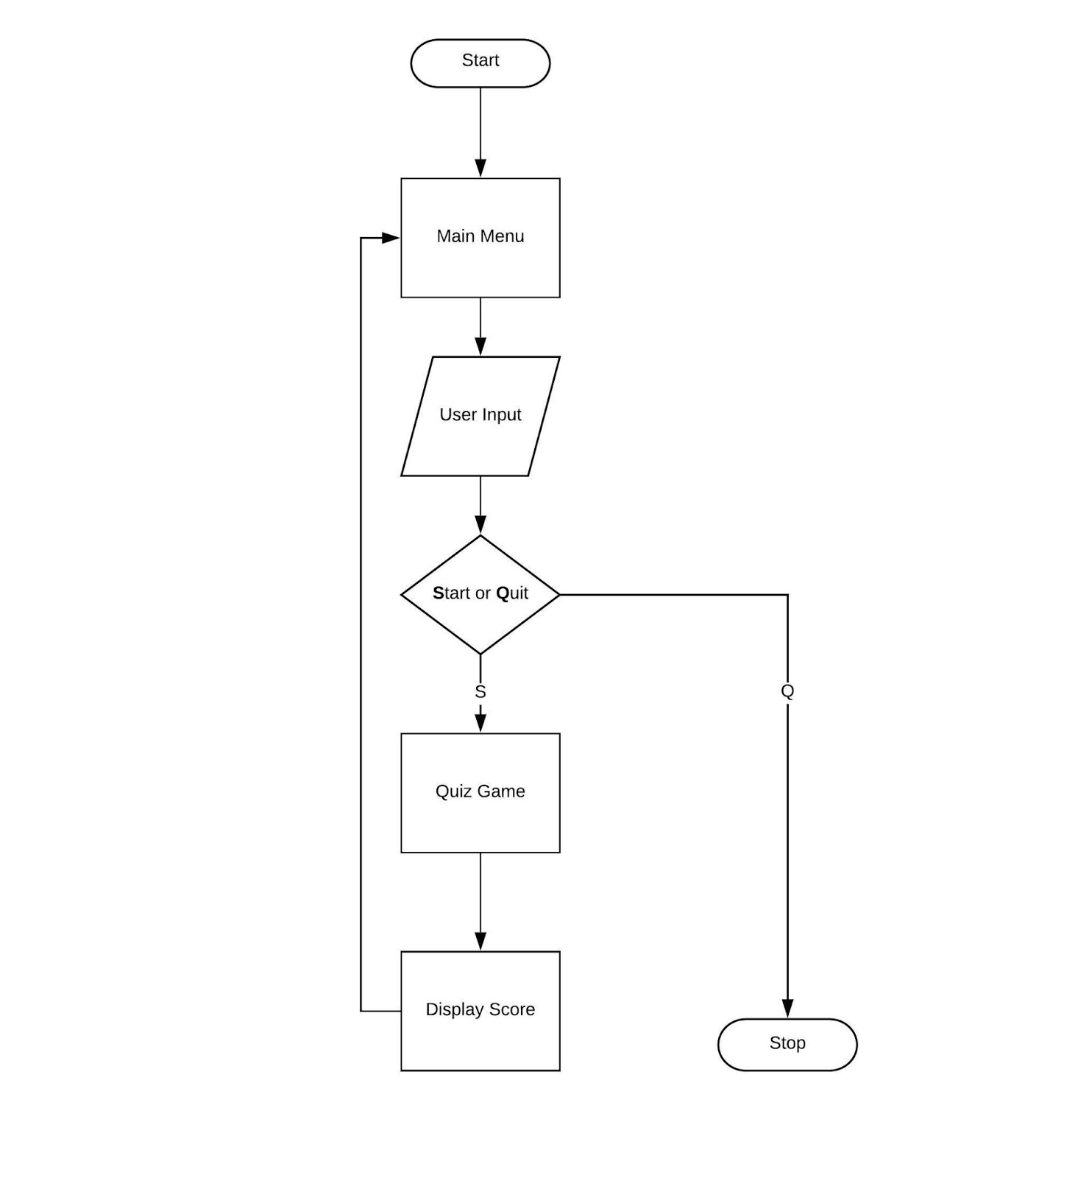
WORKING OF JAVA BRAINS

Slide 8
PROJECT OUTCOMES
It engage audience
It leads to simultaneous participation in Large number
It can serve Random questions
And, Quiz results/ gain insight in audience

Slide 9
THANK YOU!

